Slide 1

PrivacyRadar
AI-Enabled Network Intelligence and Privacy Analyzer
Mid-Semester Project Presentation October 7, 2025

Slide 2
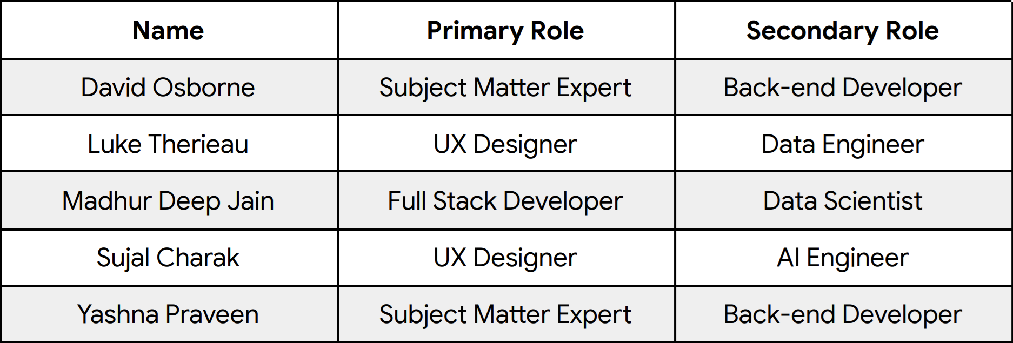
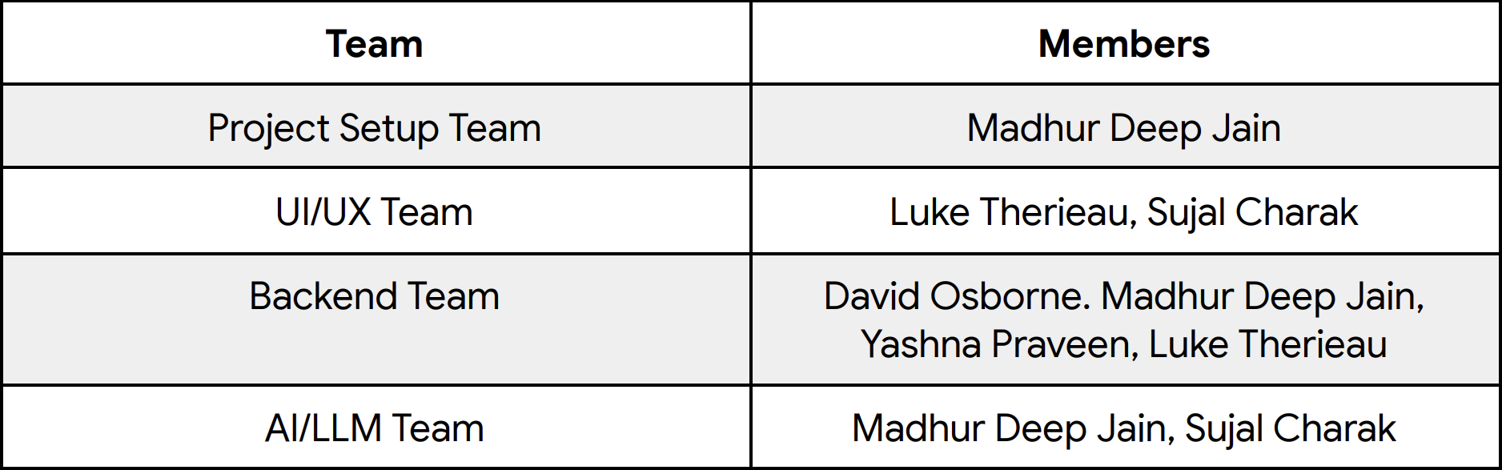
Team Structure & Responsibilities
Mid-Semester Project Presentation
October 7, 2025

Slide 3
PrivacyRadar will be a utility that provides network visibility and privacy-related activities
Will operate as a cross-platform tool, supporting Windows, Linux, and MacOS
Dashboard will includes a ‘Basic’ and ‘Advanced’ mode to satisfy the scope of its users
Will support general users who have little to no networking knowledge
Will support developers, researchers, or network administrators with years of expertise.
A comprehensive alert and notification system will be established
Alerts will be configured through both traditional UI controls and natural language commands via the AI assistant
Scope & Goals
Mid-Semester Project Presentation
October 7, 2025

Slide 4
Privacy-conscious users: Individuals seeking transparency into their applications' network behavior to discover which apps are secretly transmitting personal data, identify unexpected data collection practices that violate user expectations.
Network enthusiasts: Users who want deep insights into system-level network activity to provide granular, real-time visibility into application-specific network communications that general network tools can't offer
Security researchers & digital rights advocates: Professionals who want to automatically detect and document privacy violations at scale, collect evidence of unauthorized data collection practices, and build datasets for research publications or regulatory complaints that would be impossible to gather manually.
IT professionals: Those managing personal or small business networks who use PrivacyRadar because traditional network monitoring tools lack the application-level granularity needed to identify which specific applications are causing security concerns, consuming excessive bandwidth, or potentially exfiltrating sensitive business data through unauthorized channels.
Target Users
Mid-Semester Project Presentation
October 7, 2025

Slide 5
Functional
Network Monitoring Core Functions: capture, log, geo-locate traffic
Privacy Monitoring : detect camera, mic, location, clipboard use
Alerts & Notifications: thresholds, blacklists, privacy hardware
Data Visualization & Reports: dashboards, maps, comparisons
AI Assistant Integration: NL queries, summaries, risk scores
Data Export & Integrity: CSV/JSON/XML with filters
Non-Functional
Performance: meets RAIL model (Response ≤ 200 ms, 60 FPS UI)
Reliability: 24 h stable capture, 0 packet loss
Security: data integrity and safe storage
Scalability: 10 000 pkts/sec on 1 Gbps links
High-Level Requirements
Mid-Semester Project Presentation
October 7, 2025

Slide 6
User Stories
User Type | Goal | Benefit
Privacy-conscious user | See which apps are sending data | Identify and block invasive apps
Security researcher | Export logs for analysis | Detect privacy violations at scale
Network enthusiast | Inspect detailed packet info | Understand how apps communicate
IT professional | Get alerts for suspicious domains | Protect networks from data leaks
Casual user | Ask “Which app used my camera?” | Get easy, AI-generated explanations
Mid-Semester Project Presentation
October 7, 2025

Slide 7
What is needed to link applications with their network traffic?
  Running processes will have a PID (most of the time)
  If a process is actively using the network, it will have port(s) allocated
  Associating a PID with an application name
NodeJS cross-platform library research:
  ps-list (returns all active PIDs and names)
  netstat (returns info for all PIDs for processes with active network connections)
  cap (packet sniffer + returns network interface info)
  os (returns Windows, Linux, MacOS)
Testing:
  Read through library manuals and ran basic scripts to print output
  Basic filtering of unwanted loopback traffic
Project Setup & Core R&D
Mid-Semester Project Presentation
October 7, 2025

Slide 8
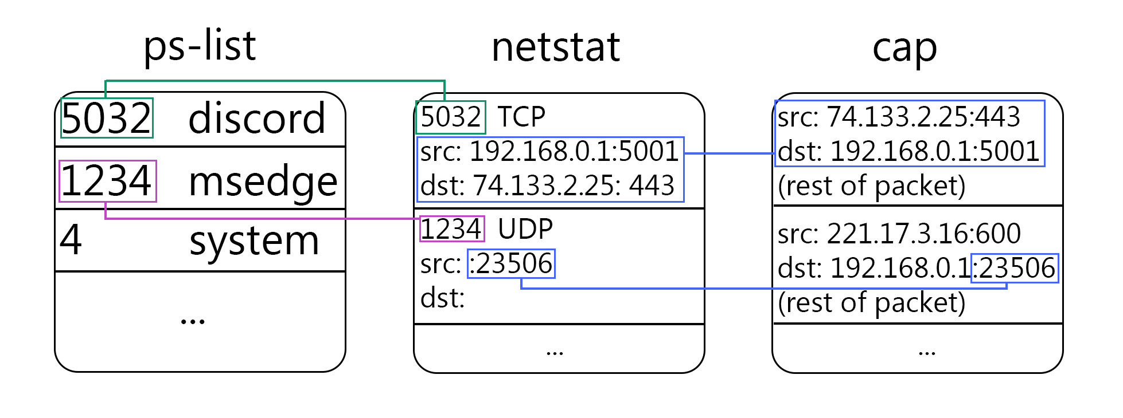
Netstat works great with TCP because it is connection oriented
UDP is not, so the full netstat information is often not there
Some system traffic may have a PID, usually it does not
Back-End Development
Pull Device/NIC info using cap
…
name: “{1CD02900-6466-....}”
description: “WAN Miniport (IP)”
addresses: [ ]
-----------------------------------------------
name “{06BE6C04-5DCD-...}
description: “Realtek PCIe GbE Controller”
addresses: [10.0.0.38, fe80::4d0a:901:...]
-----------------------------------------------
The “best” interface typically has the
most IP addresses (IPv4, v6, temp v6, link local, etc)

Slide 9
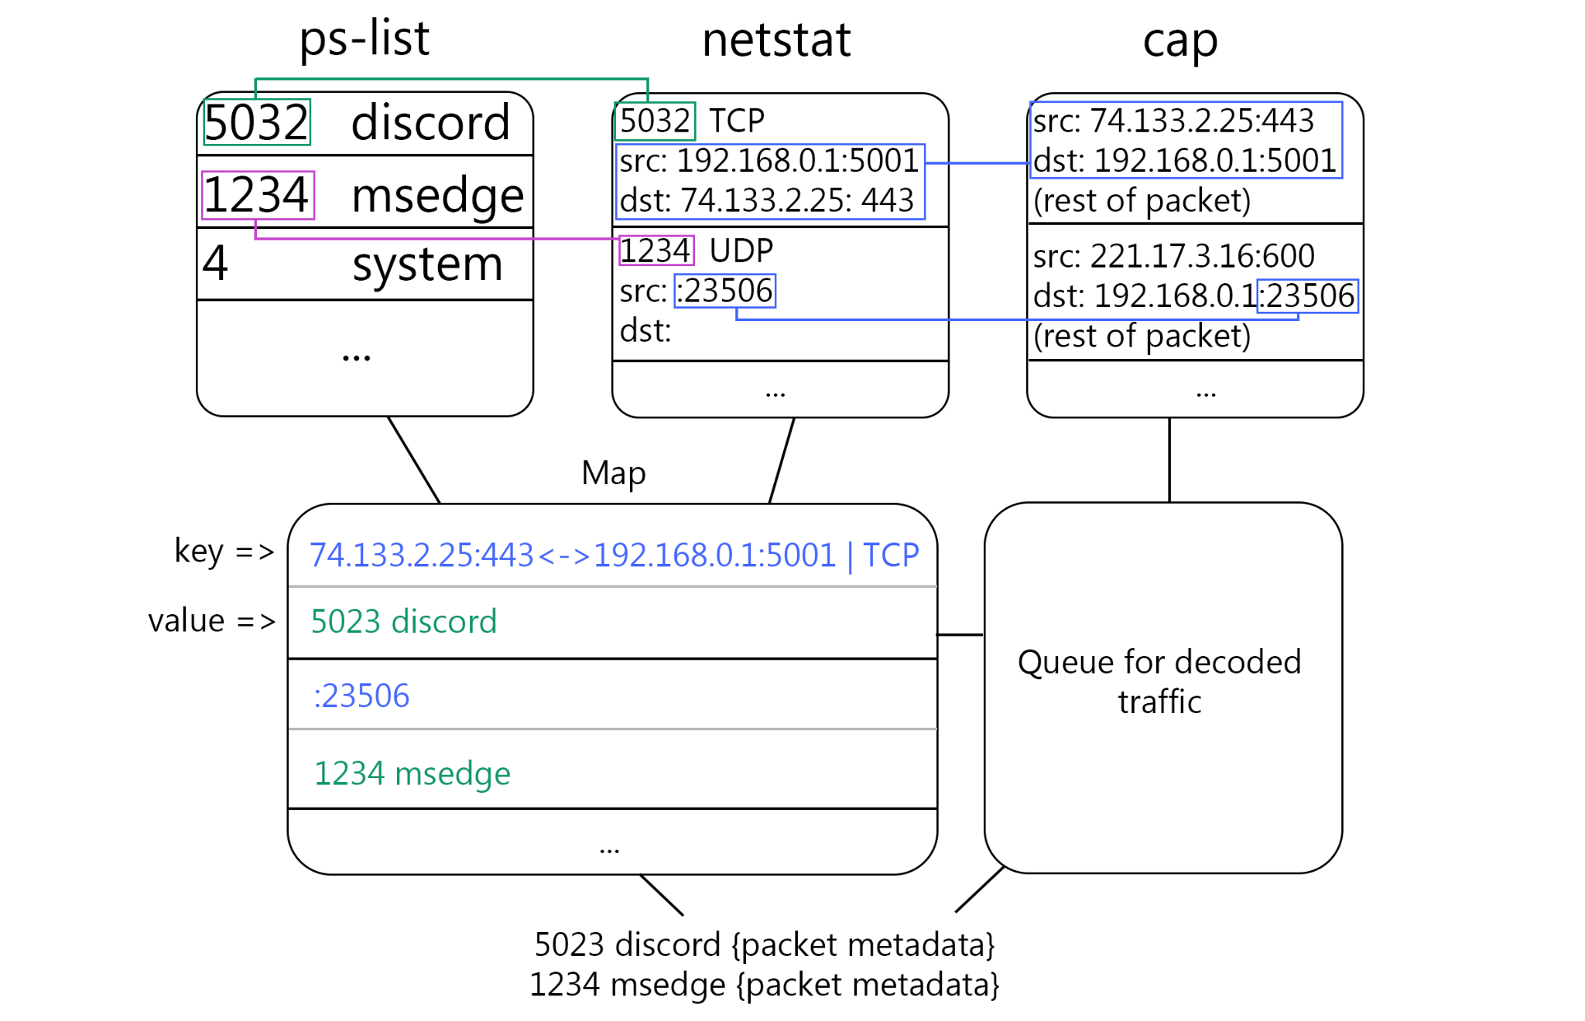
Back-End Data Processing
Ps-list and netstat are polled asynchronously
  stored in Maps
Cap runs continuously
Bidirectional key value pairs (5-tuple, PID + name) are stored in a separate Map
  Separate cached Maps for UDP and TCP
Decoded traffic uses 5-tuple key to hash in and receive PID + name
  Write to DB

Slide 10
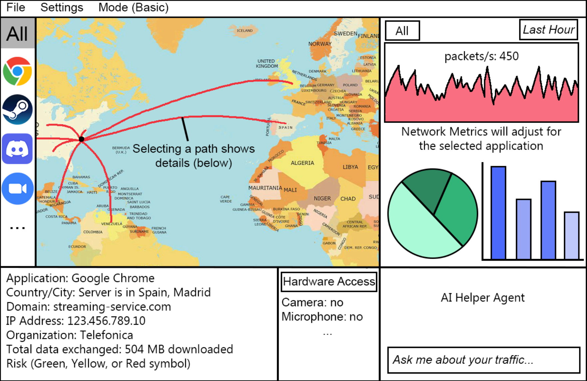
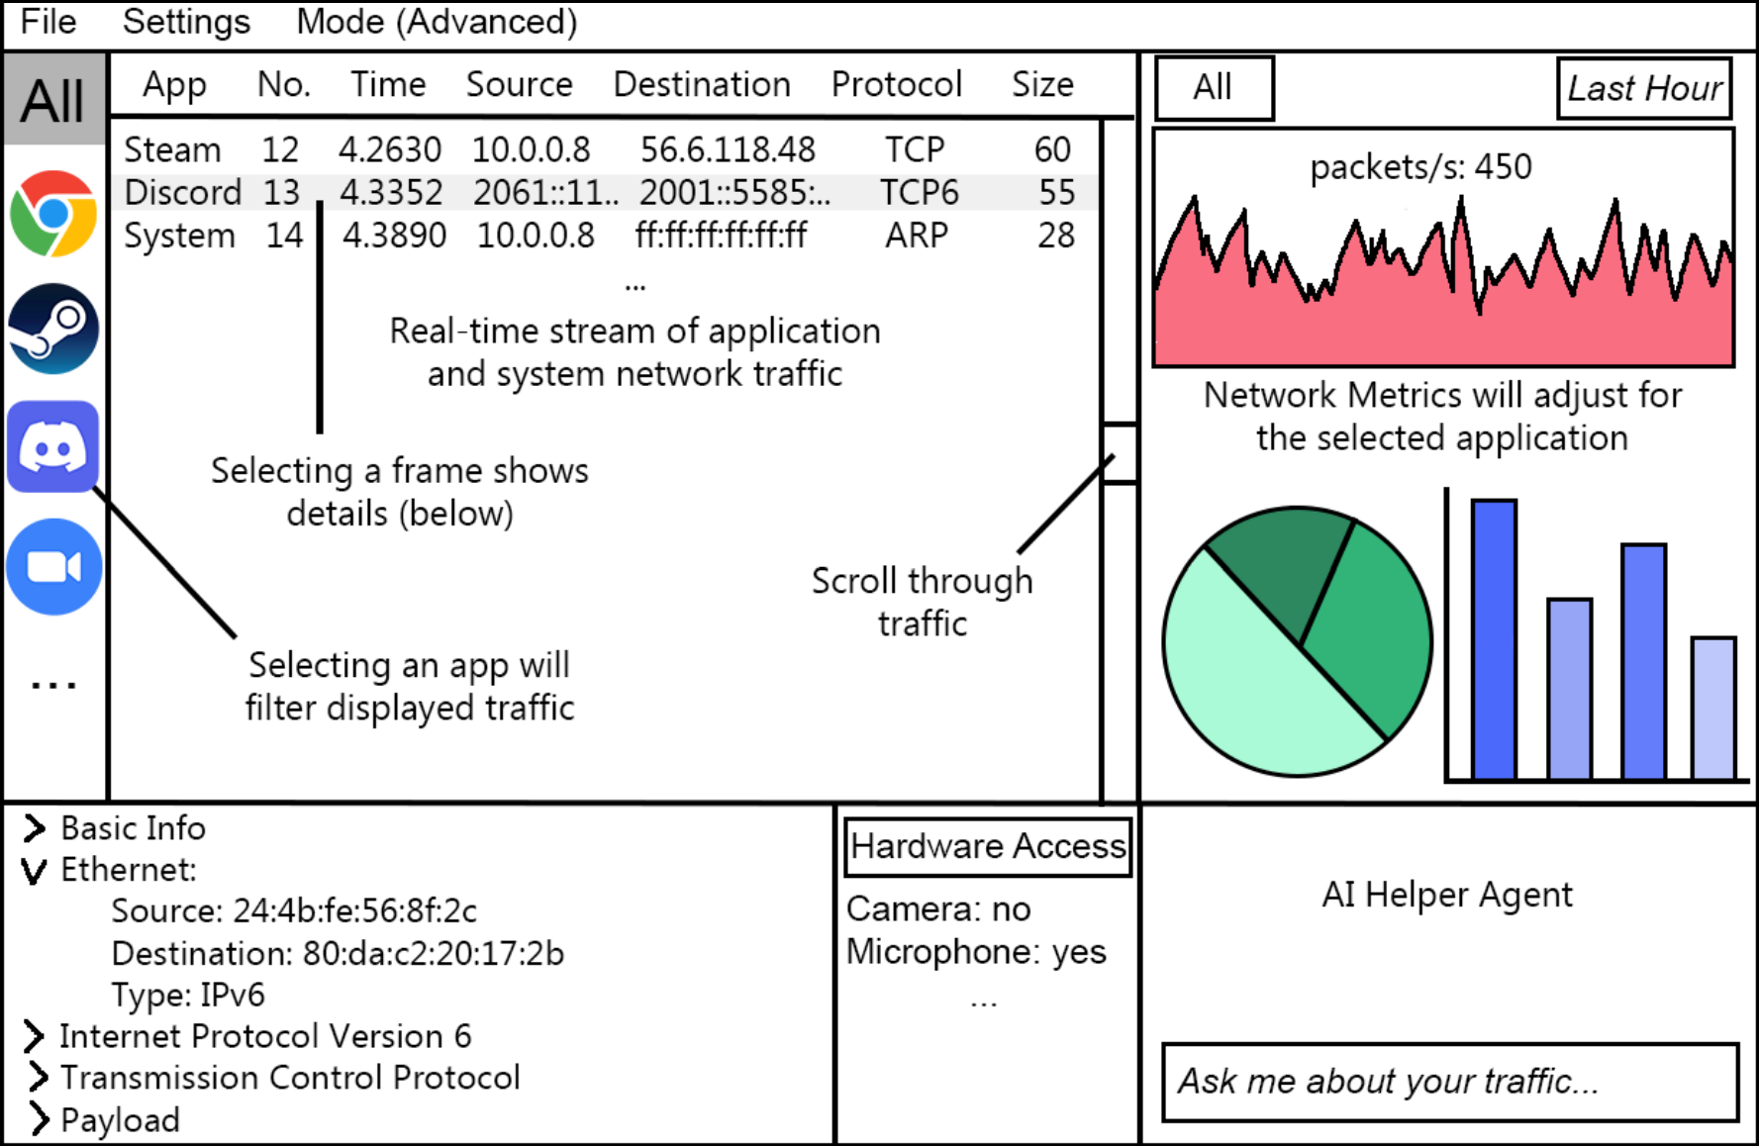
Basic Mode: Summarizes overall traffic and highlights top applications by usage, privacy scores, and recent hardware access events. Includes geographic maps showing global traffic destinations.
Advanced Mode: Provides detailed packet breakdown with header information for Ethernet, IP, and Transport layers. Includes well-known port identification, real-time traffic viewer, custom filtering, interactive timelines, and raw packet inspection.
UI/UX Design
Mid-Semester Project Presentation
October 7, 2025

Slide 11
AI-Powered Analysis
Mid-Semester Project Presentation
October 7, 2025

Slide 12
Demo
Mid-Semester Project Presentation
October 7, 2025

Slide 13
Setting up our Git repo early gave us real experience with branching, merging, and resolving conflicts as a team.
Configuring GPG keys and handling pull requests taught us how to collaborate securely and keep changes traceable.
Writing the SPMP and SCMP showed how planning, roles, and schedules help keep the project on track.
Communicating through GitHub comments and check-ins kept everyone aligned even when tasks overlapped.
Lessons Learned
Mid-Semester Project Presentation
October 7, 2025

Slide 14
Back-End Development
  Write linked packet / connection data to DB instead of JSON log files
  Handle all system network traffic not linked to processes (ARP, ICMP, DNS, DHCP, etc) by assigning PID ‘-1’ to them
  Reduce number of ‘UNKNOWN’ packets due to polling timing by implementing separate queue for unmatched packets
Next Steps & Milestones
Mid-Semester Project Presentation
October 7, 2025

